Slide 1
Akarsh Goel Olympics Dataset Data Analysis

Slide 2
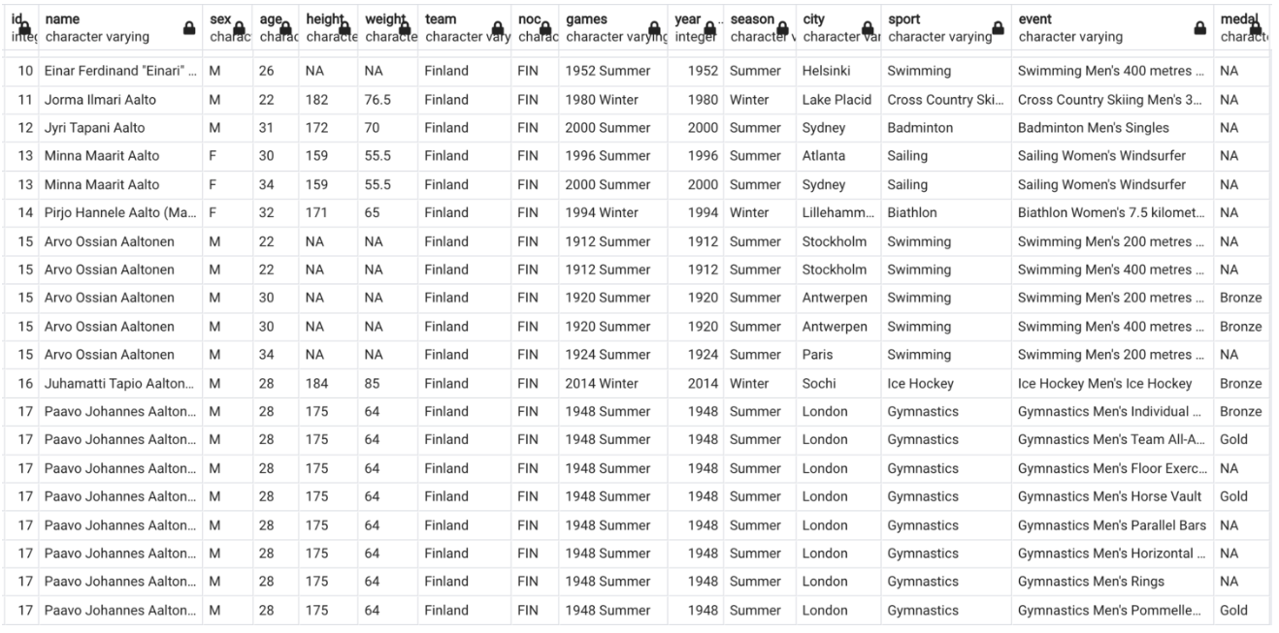
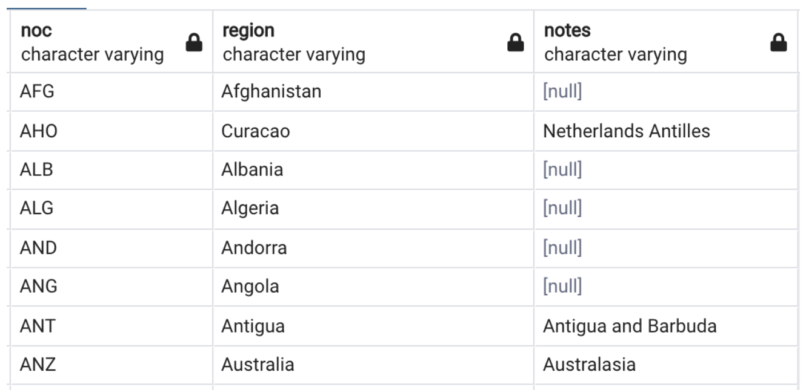
There are 2 csv files in the dataset. athletes_dataset.csv noc_regions.csv

Slide 3

How many olympics games have been held?

Slide 4
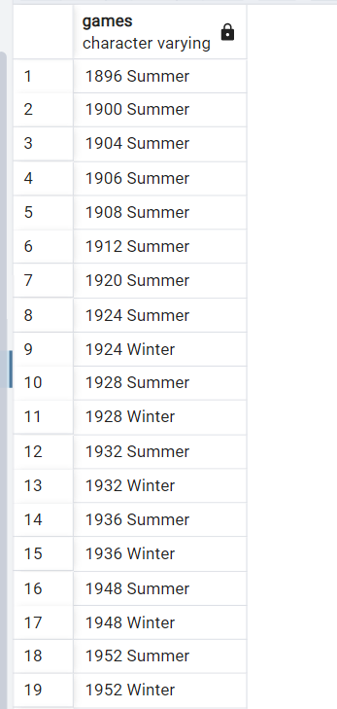

List down all Olympics games held so far.

Slide 5
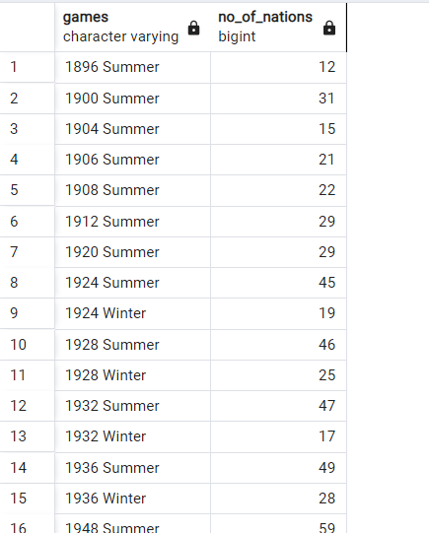
Mention the total no of nations who participated in each olympics game?

Slide 6
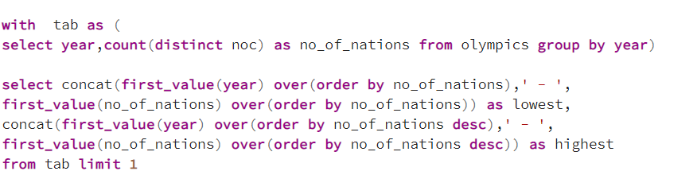

Which year saw the highest and lowest no of countries participating in olympics?

Slide 7
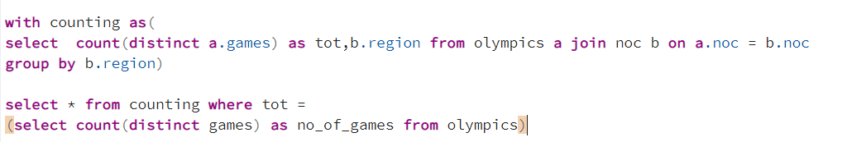
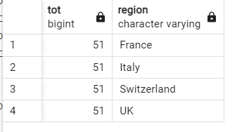
Which nation has participated in all of the olympic games?

Slide 8
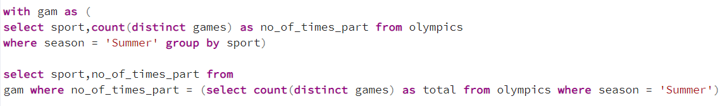
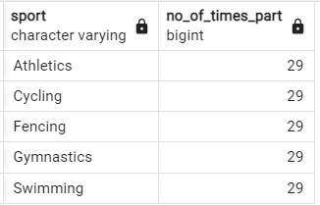
Identify the sport which was played in all summer olympics.

Slide 9
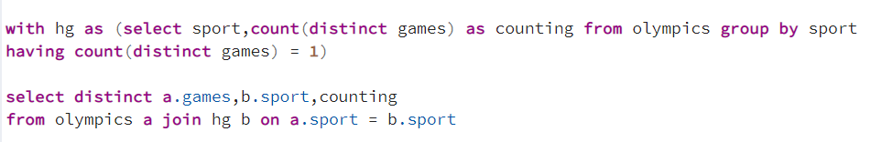
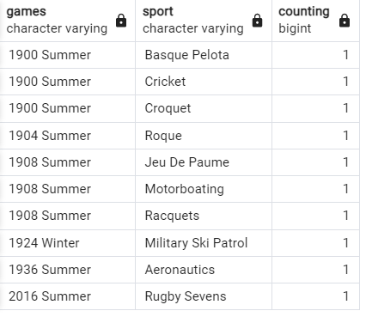
Which Sports were just played only once in the olympics?

Slide 10
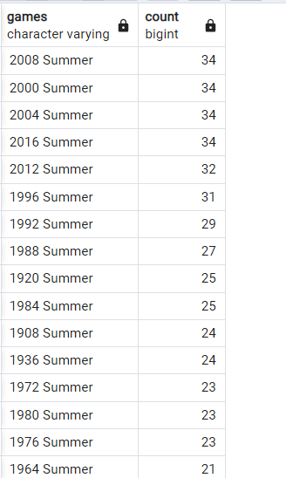
Fetch the total no of sports played in each olympic games.

Slide 11
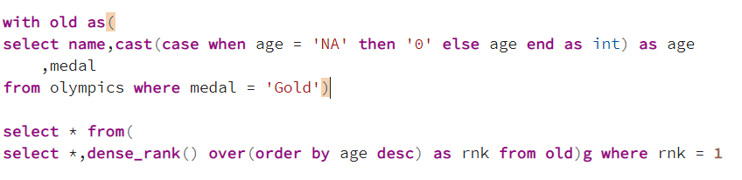
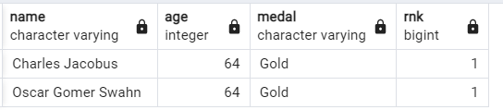
Fetch details of the oldest athletes to win a gold medal.

Slide 12
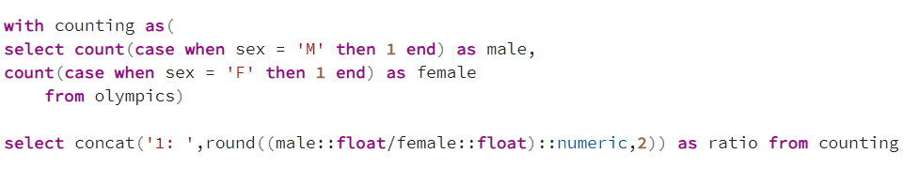

Find the Ratio of male and female athletes participated in all olympic games.

Slide 13
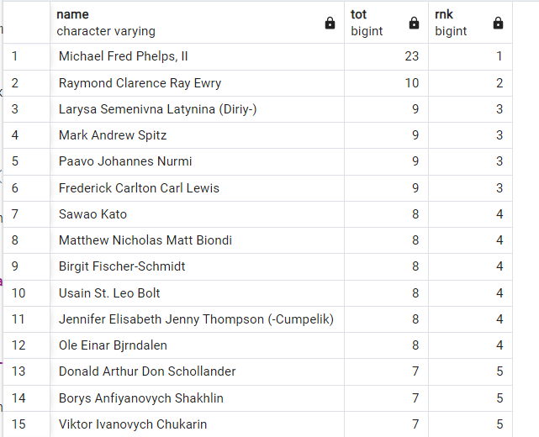
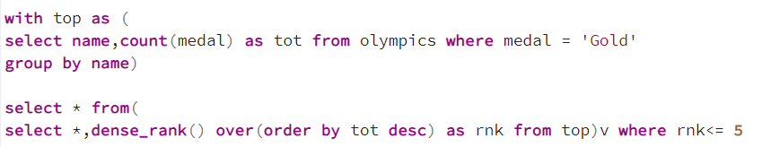
Fetch the top 5 athletes who have won the most gold medals.

Slide 14
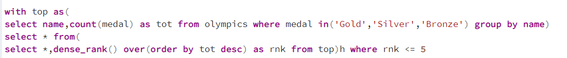
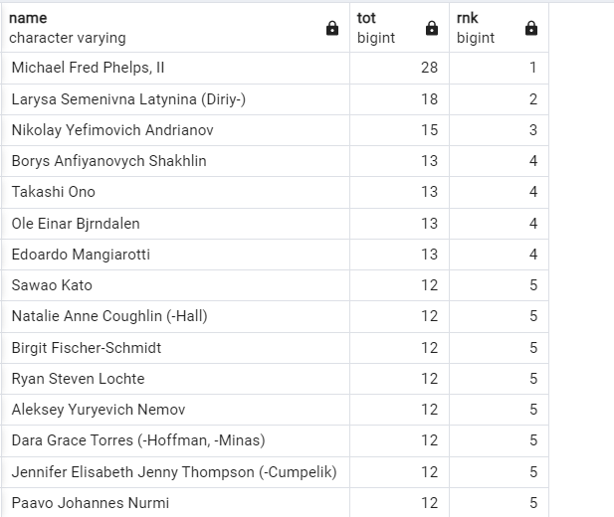
Fetch the top 5 athletes who have won the most medals (gold/silver/bronze).

Slide 15
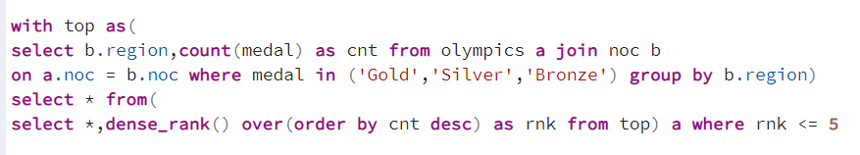
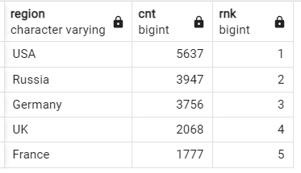
Fetch the top 5 most successful countries in olympics. Success is defined by no of medals won.

Slide 16
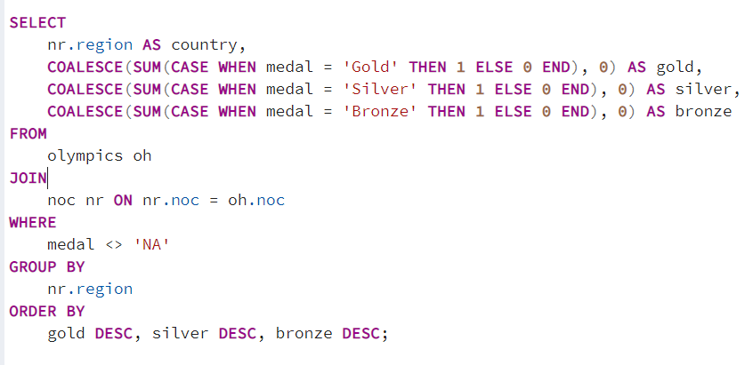
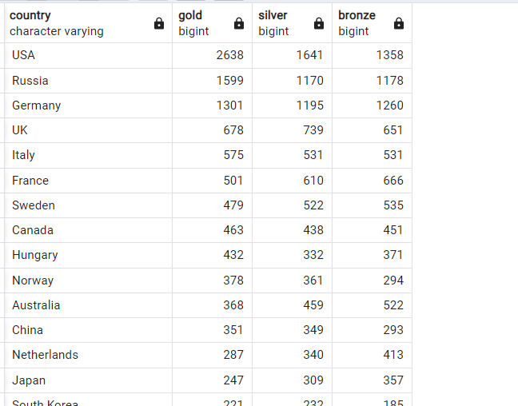
List down total gold, silver and broze medals won by each country.

Slide 17
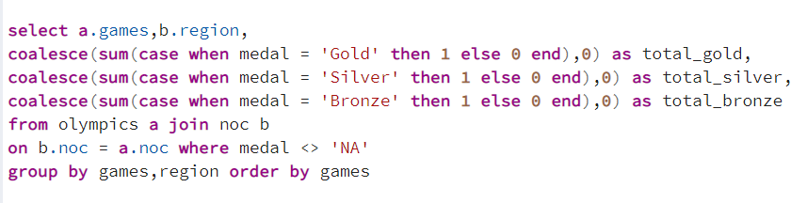
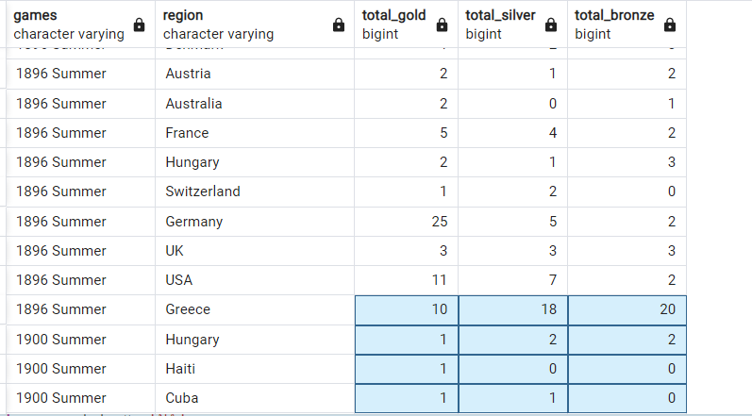
List down total gold, silver and broze medals won by each country corresponding to each olympic games.

Slide 18
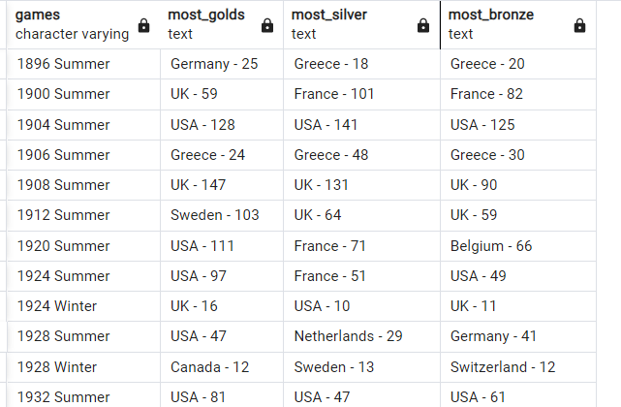
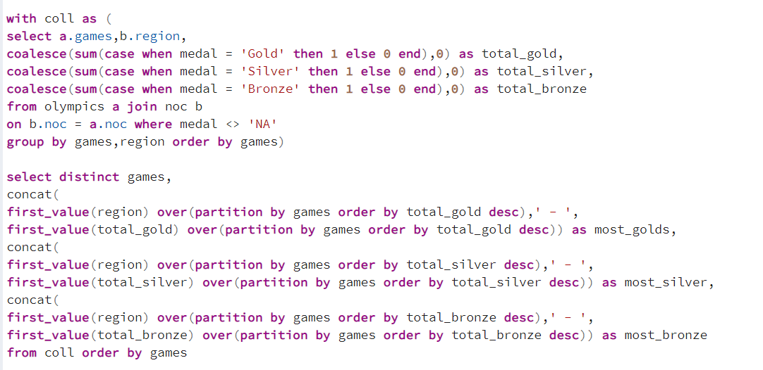
Identify which country won the most gold, most silver and most bronze medals in each olympic games.

Slide 19
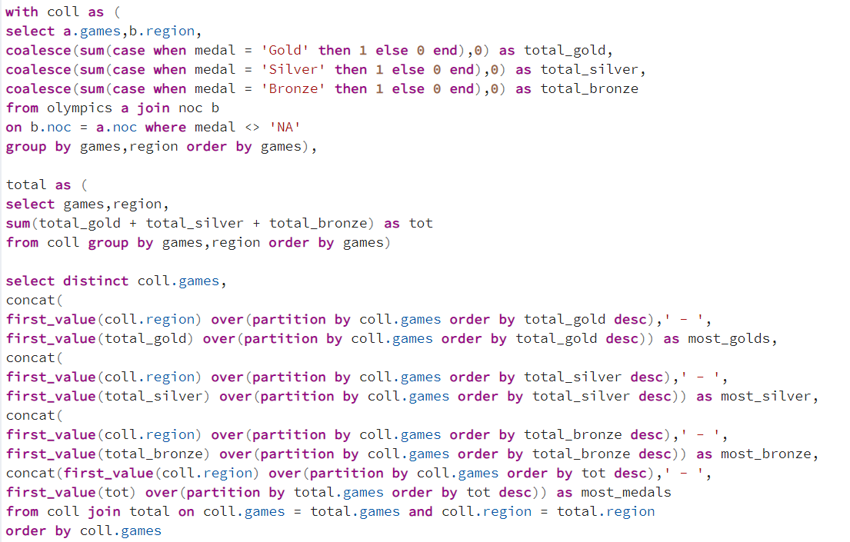
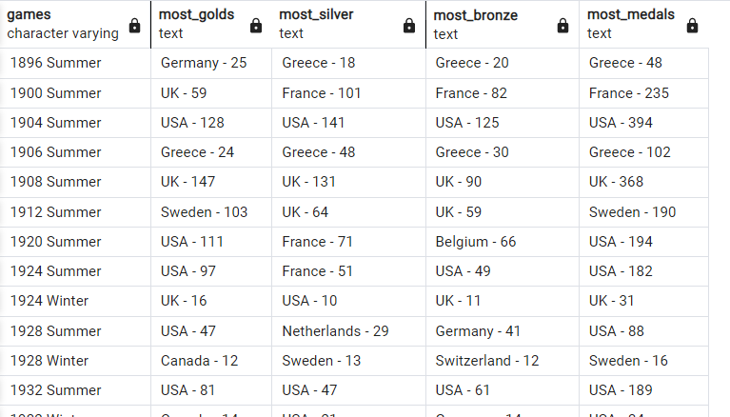
Identify which country won the most gold, most silver, most bronze medals and the most medals in each olympic games.

Slide 20
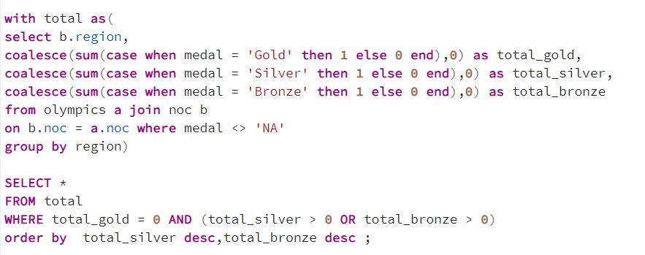
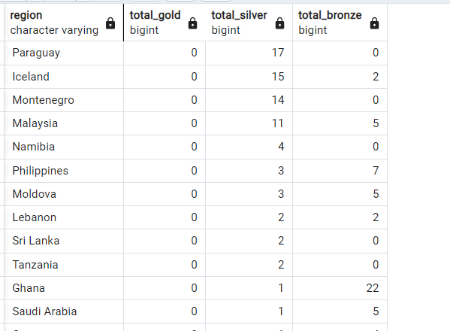
Which countries have never won gold medal but have won silver/bronze medals?

Slide 21
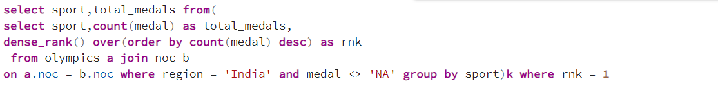

In which Sport/event, India has won highest medals.

Slide 22
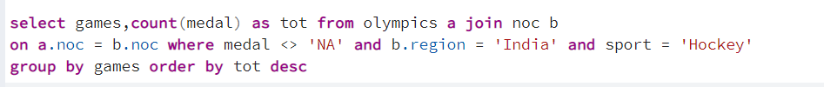
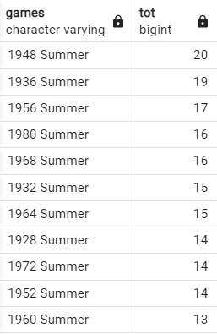
Break down all olympic games where india won medal for Hockey and how many medals in each olympic games.

